Slide 1
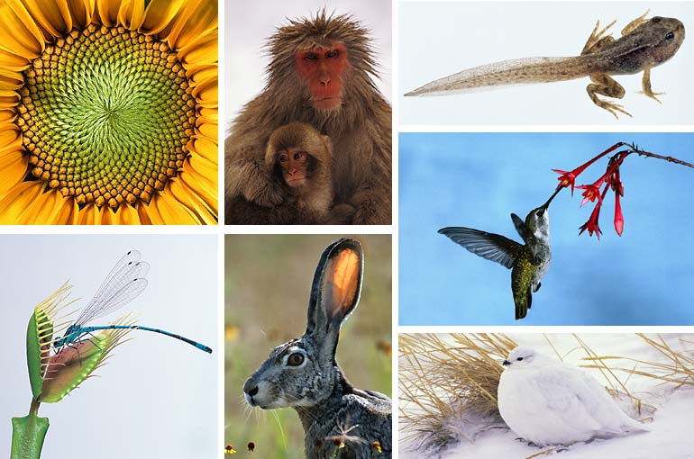
Figure 1.3 Some properties of life
How do these organisms get ENERGY? What do they need ENERGY for?

Slide 2
Cell Energy
Work is done when anything is moved. This biological work demands energy.
The cellular form of ENERGY is ATP.
ATP stands for Adenosine Triphosphate.

Slide 3
ATP
ATP is the cells energy currency. However it needs to be broken apart in order to release the energy.
ATP consists of 3 parts:
sugar group (ribose)
nitrogen base (adenine)
three phosphates

Slide 4
ATP
Adenine
Ribose
3 Phosphates

Slide 5
ATP
When a phosphate is broken off, energy is released.
The energy released powers cellular activities, such as active transport, protein synthesis, and muscle contraction.

Slide 6
ADP
Adenosine Diphosphate
Contains adenine and ribose but has only 2 phosphate groups instead of three.
When a phosphate is added to ADP then ATP is created and energy is stored.

Slide 7
ADP
Adenine
Ribose
2 Phosphates

Slide 8
ATP & ADP
Loses 1 phosphate
Releases energy
Stores Energy
Gains 1 phosphate

Slide 9
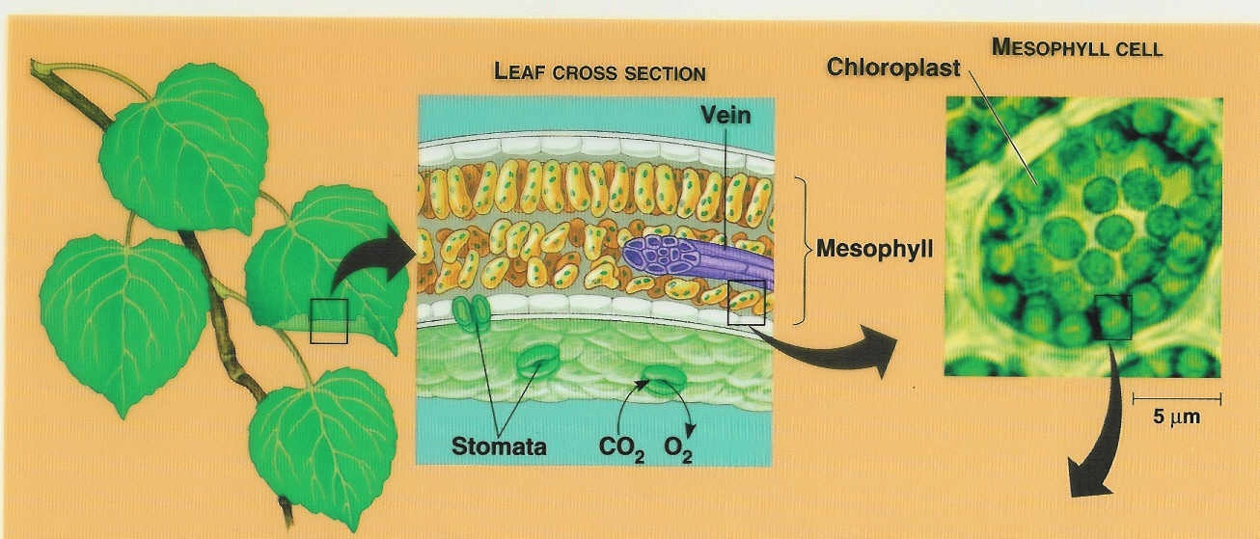
PHOTOSYNTHESIS
The process by which autotrophs make chemical energy (glucose) from light energy (sun).

Slide 10
Scientists & Photosynthesis
Van Helmont (water)
Willow Tree and Soil
Thought the tree gained mass because of water
Did not realize carbon dioxide and sunlight mattered.
Priestly (oxygen)
Glass jar over burning candle and mint sprig
Plant released oxygen

Slide 11
Scientists & Photosynthesis
Ingenhouz (sunlight)
Showed that Priestly’s experiment worked only if the plant was in the presence of sunlight.
Photosynthesis equation:
6CO₂ + 6H₂0 ----sunlight---> C₆H₁₂O₆ + 6O₂

Slide 12
Photosynthesis…
Photosynthesis equation:
6CO₂ + 6H₂0 ----sunlight---> C₆H₁₂O₆ + 6O₂
In addition to Carbon dioxide and water, sunlight and chlorophyll is needed.
Chlorophyll is a green pigment in chloroplasts that absorbs the sunlight needed for the reaction to take place.

Slide 13
CHLOROPHYLL
Two types:
Chlorophyll a: absorbs mostly blue-violet and red colors.
Chlorophyll b: absorbs mostly blue and red colors.
Both types of chlorophyll reflect green.
Plants also have a pigment called carotene that reflects some red and orange colors. (Changing of the leaves in the fall).

Slide 14
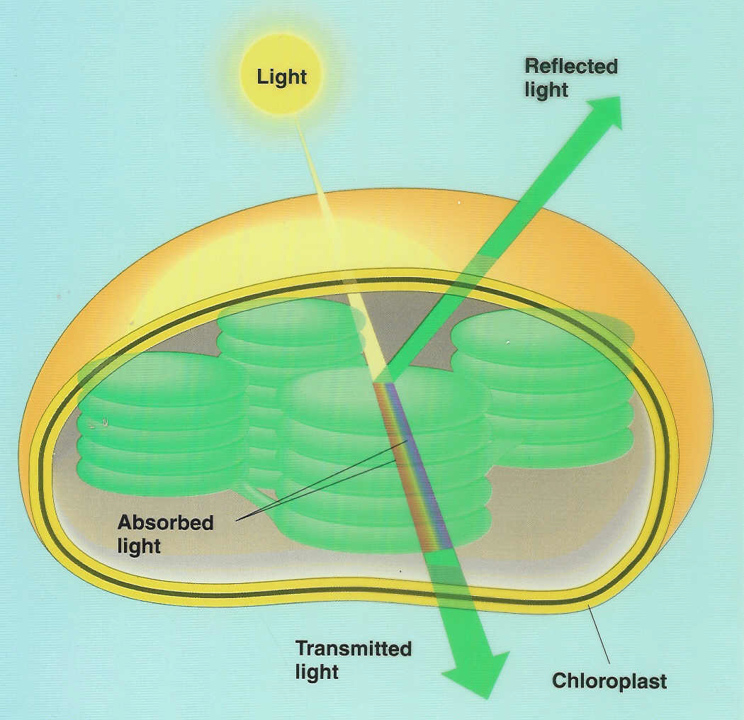
Absorption of Light
A CHLOROPLAST absorbs all wavelengths of light EXCEPT green…it reflects green light
White light = violet, blue, green, yellow, orange, red.
White = all colors reflected.
Black = all colors absorbed.

Slide 15
Process of Photosynthesis
Light Reactions: Light dependent ..NEEDS sunlight.
Dark Reactions: Light independent…does NOT matter if light is present or not.

Slide 16
Light Reactions
Take place within the thylakoid membranes
Use energy to produce ATP and NADPH (an electron carrier)
Produces oxygen gas and converts:
ADP to ATP
NADP to NADPH

Slide 17
Dark Reactions (aka Calvin Cycle)
Takes place in the stroma
Uses ATP and NADPH from the light reaction to produce high energy sugars (such as glucose)
The glucose from this reaction can be used in cellular respiration.

Slide 18
Photosynthesis

Slide 19
Factors that Control Photosynthesis
Light
Photosynthesis begins with photochemical reactions, which trap light energy and go at increased rates when the light intensity increases.
Heat
Reactions are increased by heat. Molecules move faster when heated.
Carbon Dioxide Level
Increase in amounts of CO₂ increases the rate of photosynthesis

