Slide 1
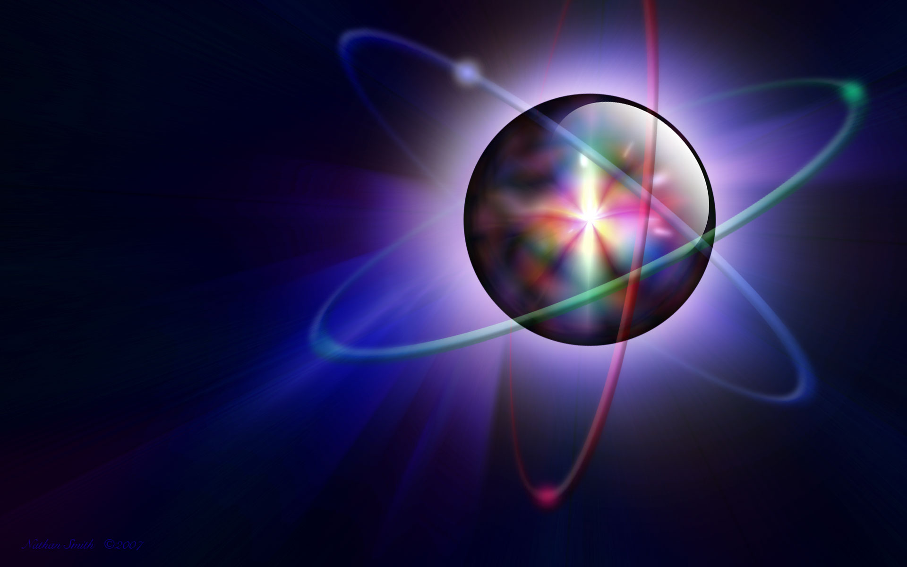
Periodic Trends
Unit 2: Electrons & Periodic Behavior

Slide 2
Periodic Law
When elements are arrange by increasing atomic number, there is a periodic repetition of their physical & chemical properties.
Periodic Trends:
Atomic Radius
Electronegativity
Ionization Energy
Metallic Character
Nonmetallic Character

Slide 3
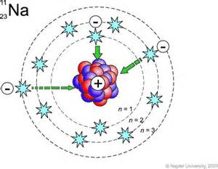
Factors Influencing Periodic Trends
Energy Level
Higher energy levels are further away from the nucleus.
Nuclear charge (# protons)
More charge pulls electrons in closer. (+ and – attract each other)
3. Shielding effect
Core electrons block the valence electrons from the full charge of the nucleus.

Slide 4
Atomic Radius (Radii)
half the distance between the nuclei of two atoms of the same element.

Slide 5
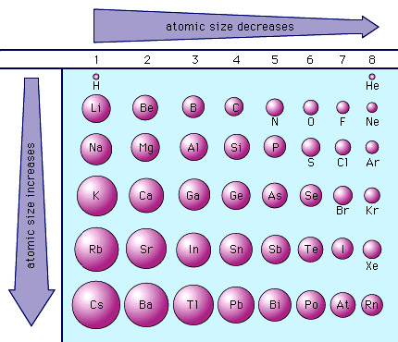
Atomic Radius (Radii)
Going down a group the atomic radius increases because each atom has another energy level so the atoms get bigger.
Going from left to right across a period, the size gets smaller. Elements have the same # of energy levels but, there is more nuclear charge so outermost electrons are pulled closer.

Slide 6
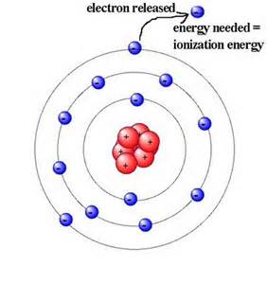
Ionization Energy (I)
The amount of energy is takes to remove a valence electron from on atom in its gaseous state.
First Ionization Energy (I₁): the amount of energy to remove the first valence electron.

Slide 7
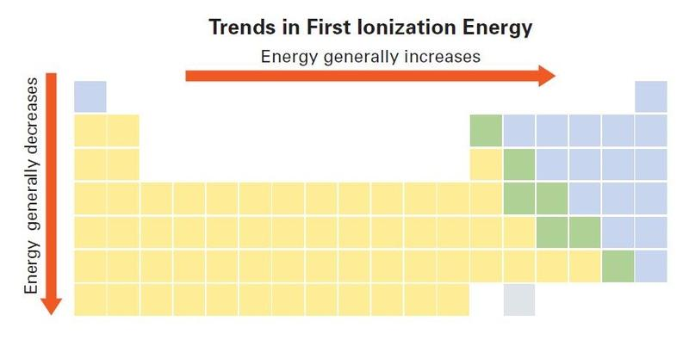
Ionization Energy (I)
As you go down a group, the ionization energy decreases because the electron is further away from the attraction of the nucleus so it is easier to remove outermost one (there is more shielding).

Slide 8
Ionization Energy (I)
Going across a period, ionization energy generally increases from left to right because the atomic radius decreases, that is, the atom is smaller. The outer electrons are closer to the nucleus and more strongly attracted to the center. Therefore, it becomes more difficult to remove the outermost electron.

Slide 9
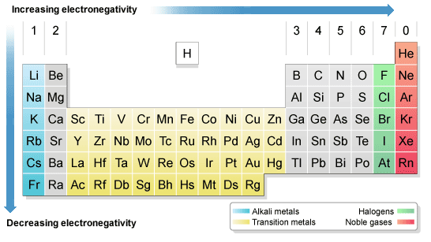
Electronegativity
Electronegativity is the tendency for an atom to attract electrons to itself when it is chemically combined with another element.

Slide 10
Electronegativity
As you go down a group the electronegativity decreases because the further down a group, the farther the electron is away from the nucleus, thus, more willing to share.

Slide 11
Electronegativity
As you move across a period, electronegativity generally increases from left to right because at the right end are the nonmetals. They want more electrons to satisfy their outer octet.

Slide 12
Electronegativity & Ionization Energy
Electronegativity is related to ionization energy.
Electrons with low ionization energies have low electronegativities because their nuclei do not exert a strong attractive force on electrons.
Elements with high ionization energies have high electronegativities due to the strong pull exerted on electrons by the nucleus.

Slide 13
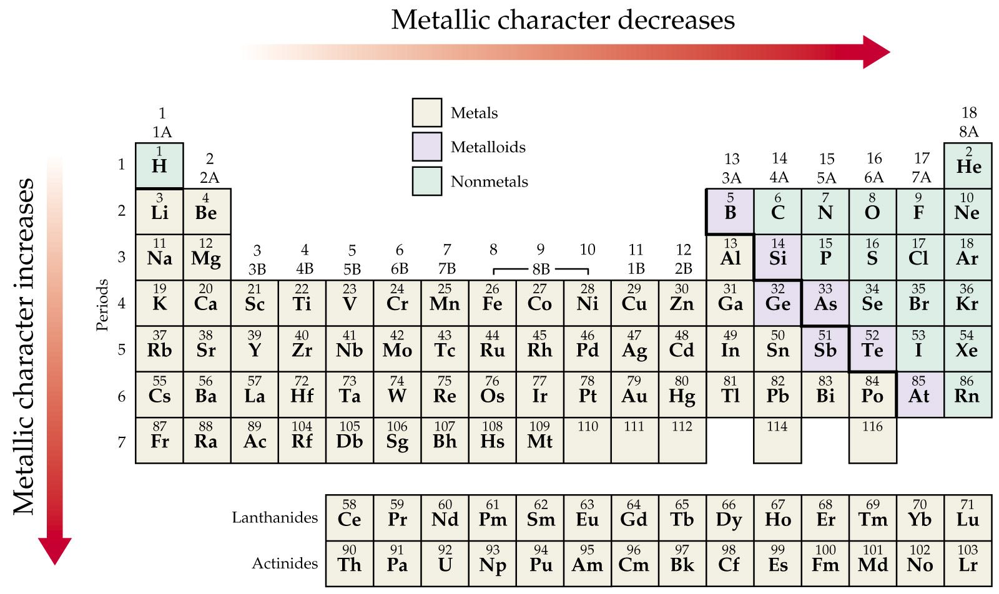
Metallic & Nonmetallic Character

Slide 14
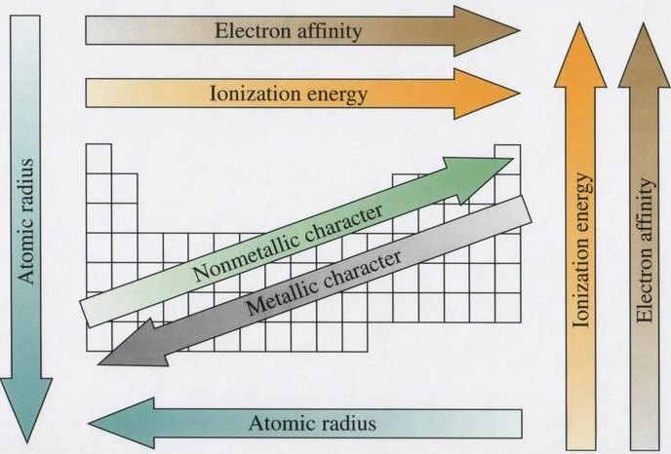
Summary of Periodic Trends
Electronegativity
Electronegativity

