Slide 1
Matter
States of Matter
Classification of Matter
Physical and Chemical Properties
Physical and Chemical Changes
Chemical Reactions
1
Notes:
1

Slide 2
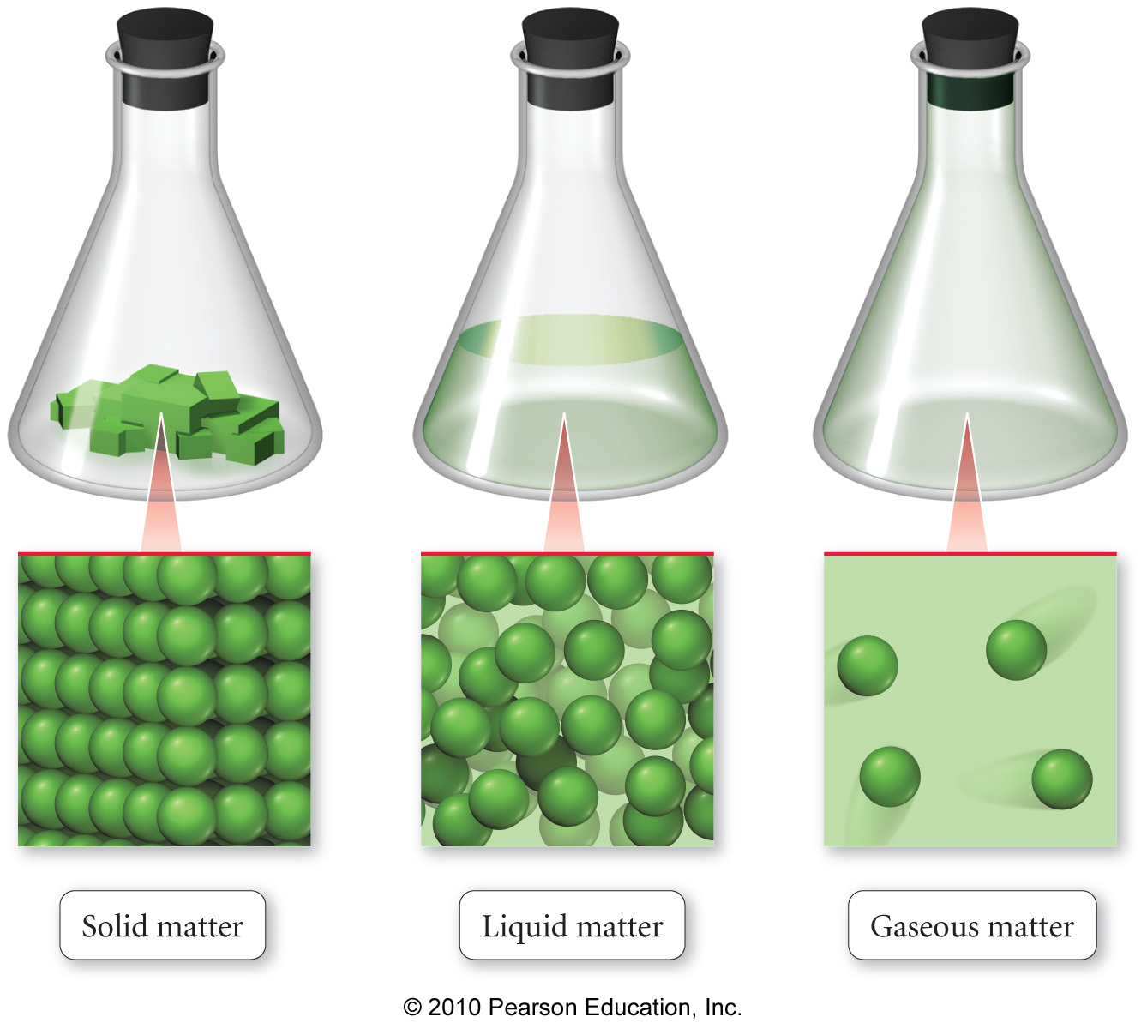
States of Matter
Matter is anything that has mass and occupies space.
We can classify matter based on whether it’s solid, liquid, or gas.
2
Notes:
2

Slide 3
States of Matter
Matter can be classified as solid, liquid, or gas based on the characteristics it exhibits.
fixed = keeps shape when placed in a container
indefinite = takes the shape of the container
3
Notes:
3

Slide 4
Solids
The particles in a solid are packed close together and are fixed in position.
though they may vibrate
The close packing of the particles results in solids being incompressible.
The inability of the particles to move around results in solids retaining their shape and volume when placed in a new container, and prevents the solid from flowing.
4
Notes:
4

Slide 5
Crystalline Solids
Some solids have their particles arranged in an orderly geometric pattern ─ we call these crystalline solids.
salt
diamonds
sugar
5
Notes:
5

Slide 6
Amorphous Solids
Some solids have their particles randomly distributed without any long-range pattern ─ we call these amorphous solids.
plastic
glass
charcoal
6
Notes:
6

Slide 7
Liquids
The particles in a liquid are closely packed, but they have some ability to move around.
The close packing results in liquids being incompressible.
The ability of the particles to move allows liquids to take the shape of their container and to flow; however, they don’t have enough freedom to escape and expand to fill the container.
7
Notes:
7

Slide 8
Gases
In the gas state, the particles have complete freedom from each other.
The particles are constantly flying around, bumping into each other and the container.
In the gas state, there is a lot of empty space between the particles.
8
Notes:
8

Slide 9
Gases
Because there is a lot of empty space, the particles can be squeezed closer together; therefore, gases are compressible.
Because the particles are not held in close contact and are moving freely, gases expand to fill and take the shape of their container, and will flow.
9
Notes:
9

Slide 10
Classifying of Matter
Another way to classify matter is to examine its composition.
composition includes:
types of particles
arrangement of the particles
attractions and attachments between the particles
10

Slide 11
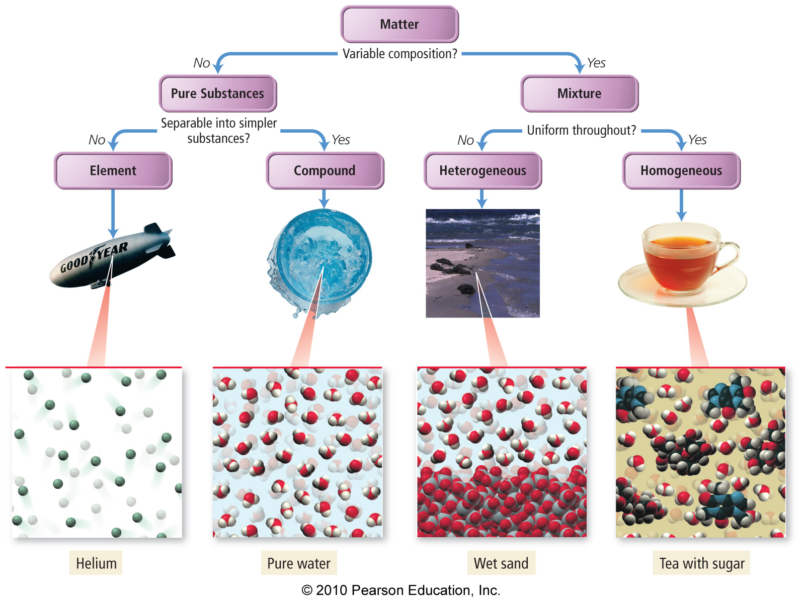
11

Slide 12
Classification of Matter
Matter whose composition does not change from one sample to another is called a pure substance.
made of a single type of atom or molecule
Because the composition of a pure substance is always the same, all samples have the same characteristics.
Matter whose composition may vary from one sample to another is called a mixture.
two or more types of atoms or molecules combined in variable proportions
Because composition varies, different samples have different characteristics.
12
Notes:
12

Slide 13
Classification of Matter
made of multiple types of particles
Samples may show different intensive properties.
made of one type of particle
All samples show the same intensive properties.
13
Notes:
13

Slide 14
Classification of Pure Substances - Elements
Pure substances that cannot be decomposed into simpler substances by chemical reactions are called elements.
decomposed = broken down
basic building blocks of matter
composed of single type of atom
though those atoms may or may not be combined into molecules
14
Notes:
14

Slide 15
Classification of Pure Substances-Compounds
Substances that can be decomposed are called compounds.
chemical combinations of elements
composed of molecules that contain two or more different kinds of atoms
All molecules of a compound are identical, so all samples of a compound behave the same way.
Most natural pure substances are compounds.
15
Notes:
15

Slide 16
Classification of Pure Substances
made of one type of atom (some elements found as multi-atom molecules in nature)
combine together to make compounds
made of one type of molecule, or array of ions
units contain two or more different kinds of atoms
16
Notes:
16

Slide 17
Classification of Mixtures
homogeneous = mixture that has uniform composition throughout
Every piece of a sample has identical characteristics, though another sample with the same components may have different characteristics.
atoms or molecules mixed uniformly
heterogeneous = mixture that does not have uniform composition throughout
contains regions within the sample with different characteristics
atoms or molecules not mixed uniformly
17
Notes:
17

Slide 18
Classification of Mixtures
made of multiple substances, whose presence can be seen
Portions of a sample have different composition and properties.
made of multiple substances, but appears to be one substance
All portions of an individual sample have the same composition and properties.
18
Notes:
18

Slide 19
Changes in Matter
Changes that alter the state or appearance of the matter without altering the composition are called physical changes.
Changes that alter the composition of the matter are called chemical changes.
During the chemical change, the atoms that are present rearrange into new molecules, but all of the original atoms are still present.
19
Notes:
19

Slide 20
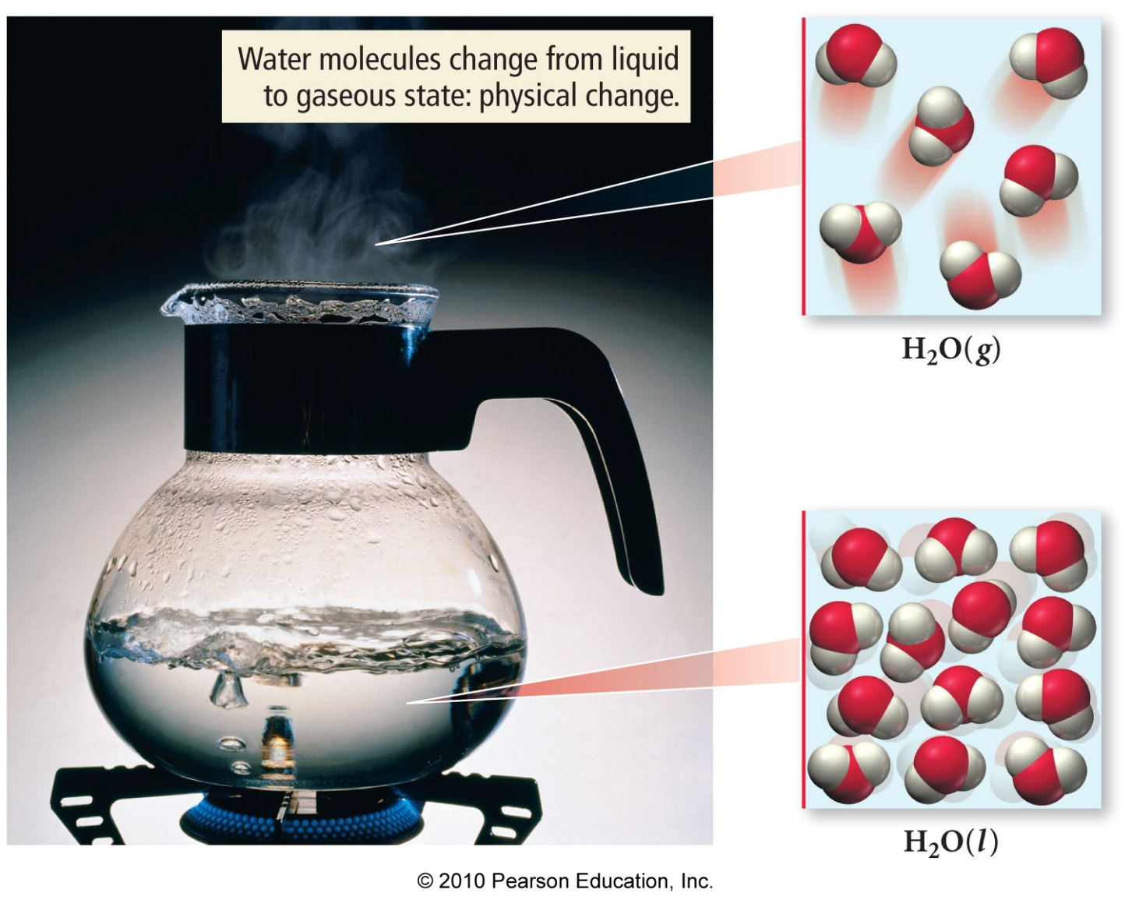
Physical Changes in Matter
The boiling of water is a physical change. The water molecules are separated from each other, but their structure and composition do not change.
20
Notes:
20

Slide 21
Common Physical Changes
Subliming of Dry Ice
processes that cause changes in the matter that do not change its composition
state changes
boiling/condensing
melting/freezing
Subliming
dissolving
CO₂(g)
Dry Ice
CO₂(s)
Dissolving of Sugar
C₁₂H₂₂O₁₁(s)
C₁₂H₂₂O₁₁(aq)
21
Notes:
21

Slide 22
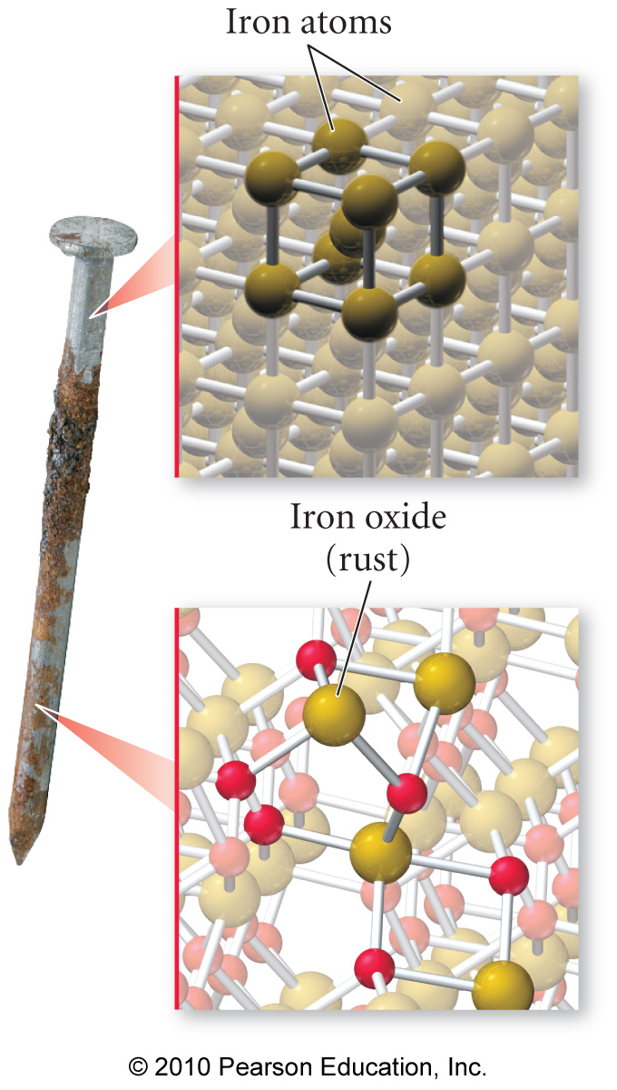
Chemical Changes in Matter
The rusting of iron is a chemical change. The iron atoms in the nail combine with oxygen atoms from O₂ in the air to make a new substance, rust, with a different composition.
22
Notes:
22

Slide 23
Common Chemical Changes
processes that cause changes in the matter that change its composition
rusting
processes that release lots of energy
burning
C₃H₈(g) + 5 O₂(g) → 3 CO₂(g) + 4 H₂O(l)
23
Notes:
23

Slide 24
Properties of Matter
Physical properties are the characteristics of matter that can be changed without changing its composition.
characteristics that are directly observable
Chemical properties are the characteristics that determine how the composition of matter changes as a result of contact with other matter or the influence of energy.
characteristics that describe the behavior of matter
24
Notes:
24

