Slide 1
DNA
Biology
By PresenterMedia.com

Slide 2
DNA: Deoxyribonucleic Acid
Chromosomes are made of DNA
Small pieces of DNA that code for traits are called genes.
DNA is shaped like a twisted ladder. We call this shape a double helix.

Slide 3
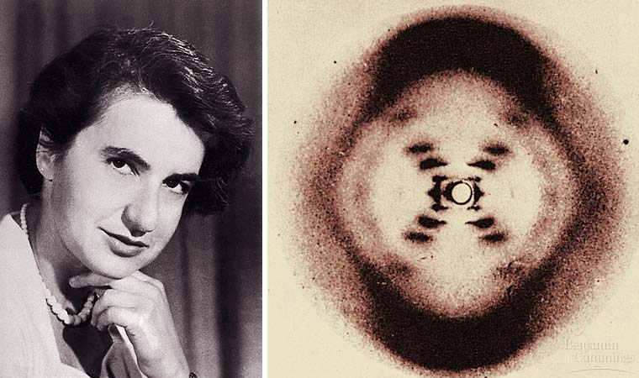
ROSALIND FRANKLIN had produced a photo made by passing Xrays through DNA and recording the interference patter. By studying the photo, Watson & Crick realized DNA must have a spiral structure.

Slide 4
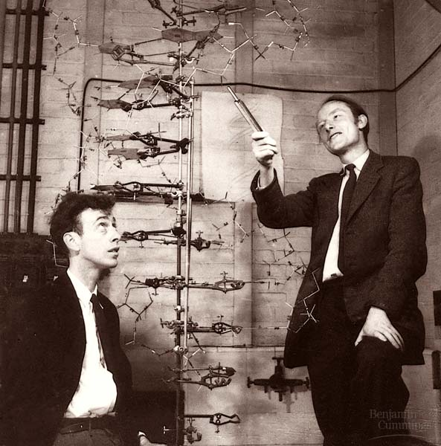
Watson and Crick
In 1953, James Watson & Francis Crick made the first model of DNA that showed its structure.
In 1962, Watson & Crick won the Nobel Prize for discovering the structure of DNA.

Slide 5
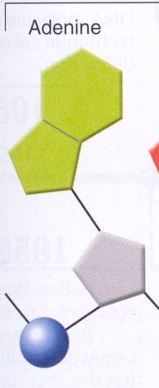
DNA is made of small subunits called NUCLEOTIDES. A nucleotide consists of 3 parts.
Nitrogen Base
Adenine (A)
Guanine (G)
Cytosine (C)
Thymine (T)
Deoxyribose Sugar (5 carbon sugar)
Phosphate Group

Slide 6
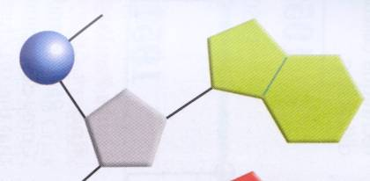
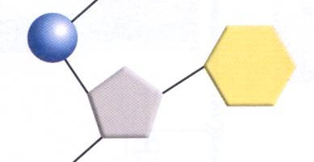
Nitrogen Bases
Purines
“Double Rings”
Longer
Examples
Adenine
Guanine
Pyrimidines
“Single Rings”
Shorter
Examples
Cytosine
Thymine

Slide 7
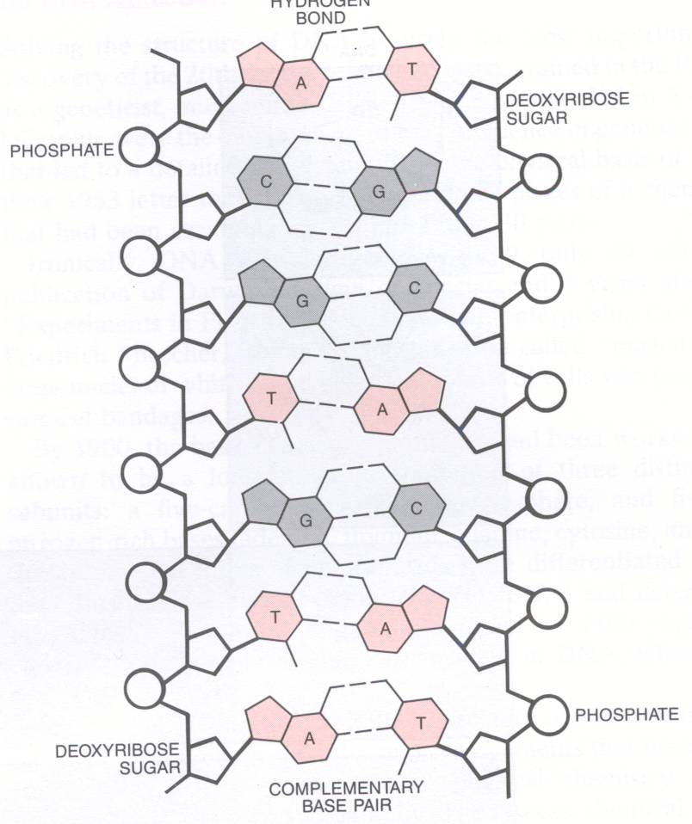
*Sides:Sugar & phosphates
*Rungs:Bases
A pairs with T
C pairs with G
*Attached with weak hydrogen bonds

Slide 8
How do the 4 bases interact?
The nitrogenous bases are complimentary because they will only bond with a certain partner. If you know half of a DNA molecule, you can easily determine the missing half.
Chargaff’s Rule:
A and T pair
C and G pair
A-T-G-G-C-T-G-C
T-A-C-C-G-A-C-G
Complementary Base Pairs

Slide 9
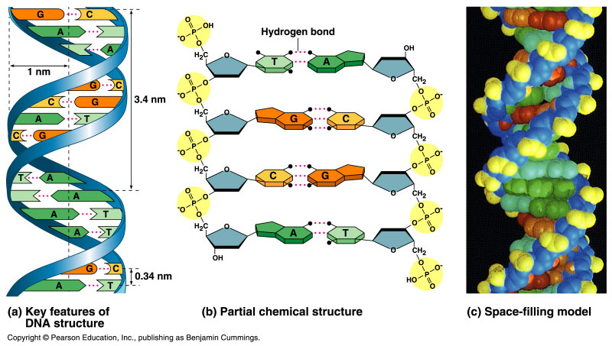
Figure 16.5 The double helix

Slide 10
DNA REPLICATION
REPLICATION: Process in which DNA copies itself exactly. This occurs during interphase of the cell cycle.

Slide 11
Steps of DNA Replication
1)DNA unzips- an enzyme breaks the bonds between the nitrogen bases
2) There are now 2 strands of DNA called parent strands.

Slide 12
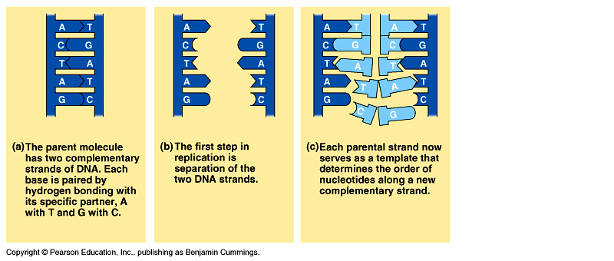
Steps of DNA Replication
Free floating nitrogenous bases (A, T, G, and C’s) match up to their partners on the parent strands.
The enzyme called DNA polymerase bonds the nitrogenous base pairs together.

Slide 13
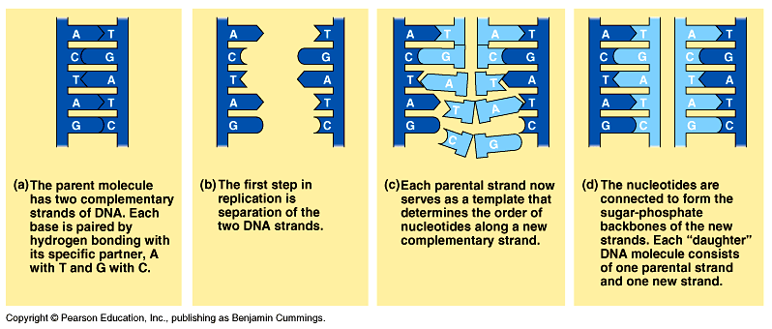
Steps of DNA Replication
Sugars and phosphates bond to form new sides of the DNA ladder.
End Result = 2 identical copies of the DNA double helix.

