Slide 1
Cell Boundaries
Permeability & Transportation of Molecules

Slide 2
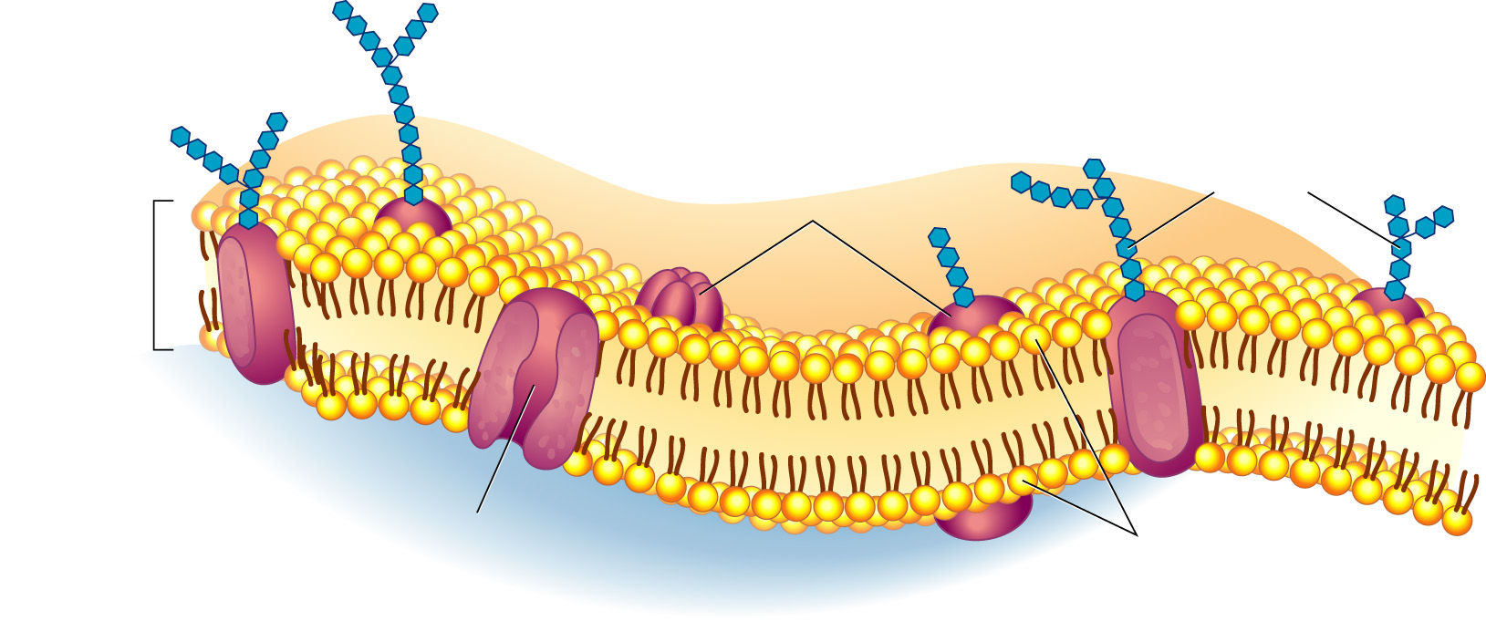
Cell Membrane
All cells are surrounded by a cell membrane
Thin, flexible barrier
Regulates what enters and leaves the cell
Provides protection and support for the cell
Communicates with other cells
Outside
of cell
Carbohydrate
chains
Proteins
Cell
membrane
Inside
of cell
(cytoplasm)
Protein
channel
Lipid bilayer

Slide 3
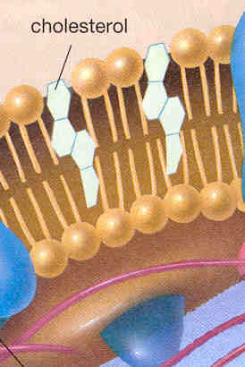
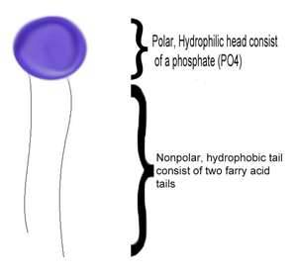
Components of the Cell Membrane
Phospholipids
Cholesterol
Loves Water
Hates Water
Makes the bilayer stronger but still flexible
Holds two layers together

Slide 4
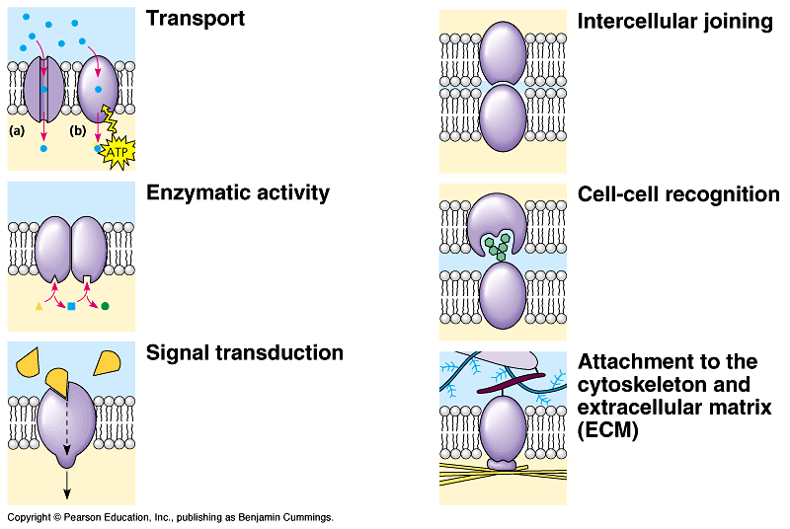
Components of the Cell Membrane
Proteins – have many functions in the membrane

Slide 5
Cell Walls
Plant cells are surrounded by a cell wall
Tough layer outside the cell membrane
Gives support and protection for the cell

Slide 6
Key Vocabulary
Solute
Substance that is dissolved in a solvent to make a solution
Solvent
Substance in which a solute is dissolved to form a solution
Solution
Mixture of two or more substances in which the molecules of the substances are evenly distributed

Slide 7
Concentration
The mass of a solute in a given volume of solution
Ex. If you dissolved 12 grams of salt in 3 liters of water, the concentration would be 12g/3L or 4g/L. If you dissolved 12 grams of salt in 6 liters of water, the concentration would be 12g/6L or 2g/L. The first solution is twice as concentrated at the second solution.

Slide 8
Hypertonic
Describes the side of the membrane with the higher concentration

Slide 9
Hypotonic
Describes the side of the membrane with the lower concentration

Slide 10
Isotonic
When both sides of the membrane are in equal concentrations

Slide 11
Comparison: Hypertonic/Hypotonic

Slide 12
What Occurs to Cells in Various Solutions

Slide 13
Equilibrium
When the concentration of a solute is equal throughout the solution
Once equilibrium has been reached, particles continue to move across the membrane in both directions

Slide 14
Transport Across the Cell Membrane
Passive Transport – Does NOT require energy
Diffusion
Osmosis
Facilitated Diffusion
Active Transport – DOES require energy
Endocytosis
Exocytosis
Membrane Pump

Slide 15
Passive Transport
Diffusion: The process where molecules in a solution randomly move from an area of higher concentration to an area of lower concentration

Slide 16
Passive Transport
Osmosis
Diffusion of water through a selectively permeable membrane

Slide 17
Passive Transport
Glucose
molecules
Facilitated Diffusion
Diffusion of specific molecules performed by the channels of protein in the cell membrane
Process is fast and specific (Only 1 type of molecule can pass through each protein channel)
Glucose
molecules
High
Concentration
Cell
Membrane
Low
Concentration
Protein
channel

Slide 18
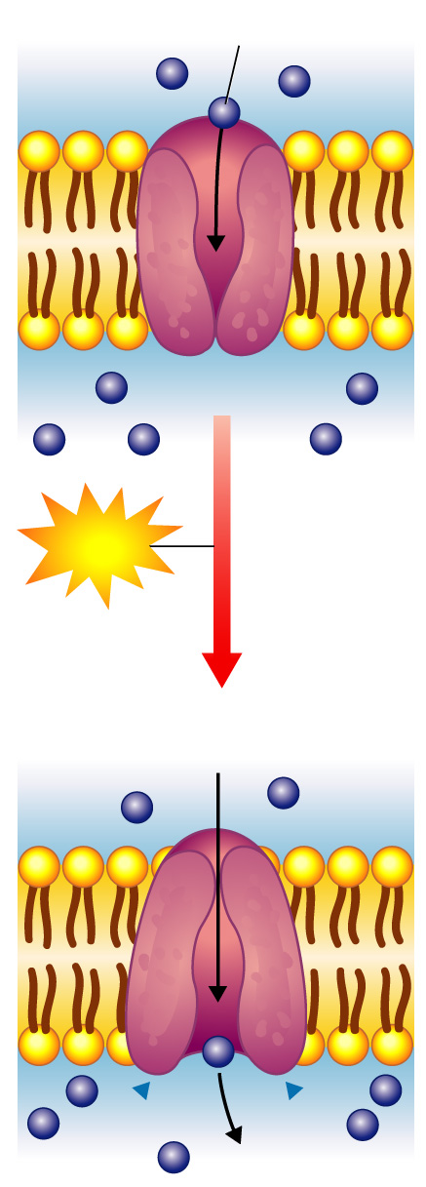
Active Transport
Active Transport
Diffusion in the opposite direction
From an area of lower concentration to an area of higher concentration
Specific molecules move through transport proteins or “pumps” (aka Membrane Pumps)
Molecule to
be carried
Energy
Molecule
being carried

Slide 19
Active Transport
Larger molecules move through processes called Endocytosis (movement of molecules into the cell) and Exocytosis (movement of molecules out the cell)

Slide 20
2 Types of Endocytosis
Phagocytosis
Extensions of the cytoplasm surround a particle and package it within the vacuole

Slide 21
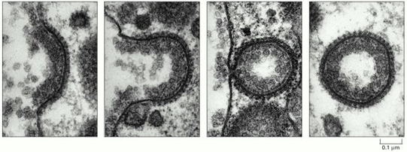
2 Types of Endocytosis
Pinocytosis
Pockets form along the cell membrane, fill with liquid, and pinch off to form vacuoles within the cell

Slide 22
Comparison: Diffusion, Facilitated Diffusion, Active Transport

