Slide 1
Atomic Structure
Chemistry, Unit 1

Slide 2
Essential Question
How has the model of atomic structure changed over time?

Slide 3
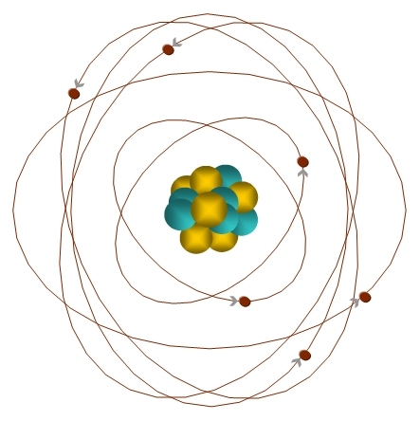
The Atom
Electron
The smallest unit of matter with its own unique
set of properties.
Proton
Neutron

Slide 4
Subatomic Particles
Particle | Symbol | Relative Charge (to each other) | Relative Mass (to each other) | Actual Mass (grams)
Electron | e⁻ | 1- | 1/1840 | 9.11 x 10⁻²⁸
Proton | p⁺ | 1+ | 1 | 1.67 x 10⁻²⁴
Neutron | n⁰ | 0 | 1 | 1/67 x 10⁻²⁴

Slide 5
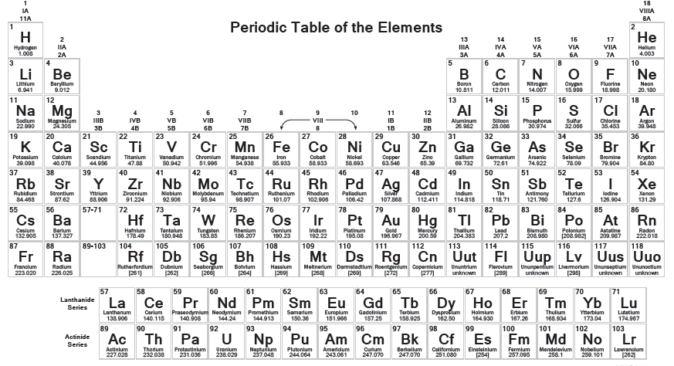
Types of Atoms
118 Elements

Slide 6
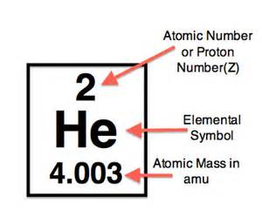
The Neutral Atom
Atomic Number (Z) =
# of protons
Mass Number (A) =
# protons + # of neutrons
Neutral means no charge so
# protons = # of neutrons

Slide 7
The Neutral Atom
Helium:
2 protons +2
2 electrons 2
2 neutrons 0
Overall 0
Charge (neutral)

Slide 8
Atomic Symbol
Mass Number
Atomic Symbol for Helium
Element Symbol
Atomic Number

Slide 9
Ions
Atoms can gain or lose electrons, causing them to be positively or negatively charged. We call these charged atoms IONS.
Positive Ion:
Ca²⁺
20 protons +20
20 neutrons 0
? Electrons -?
Overall Charge +2
Negative Ion:
Cl¹⁻
17 protons +17
18 neutrons 0
? Electrons -?
Overall Charge -1

Slide 10
Isotopes
Not all atoms of the same element are the same. Ions have a different number of electrons, causing the atom to become charged.
Atoms of the same element can also have a different number of neutrons. We call these Isotopes.
Carbon-12 Carbon-14
6 protons 6 protons
6 electrons 6 electrons
6 neutrons 8 neutrons

